Slide 1
Low Pass FIR Filter Design
Binit Kumar Pandit

Slide 2
Required Specifications
Pass band edge frequency (f_{p}) = 10 Hz.
Stop band edge frequency (f_{s}) = 11 Hz.
Pass band ripple (R_{p}) ≤ 1 dB.
Stop band attenuation(A_{s}) ≥ 60 dB.
Window Type = Blackman Window.

Slide 3
Blackman Window
Window Definition:
,0 ≤ n ≤ M-1
,otherwise
Minimum Stopband Attenuation = 74 dB.

Slide 4
Formulae
Normalized Passband frequency: w_{p}= 2πf_{p} / f_{sample}
Normalized Stopband frequency: w_{s}=2πf_{s} / f_{sample}
Transition Width: w_{tf} = w_{s} – w_{p}
Order of Blackman Window: N = M – 1 = 11π/w_{tf}

Slide 5
Order at different Sampling Frequency
f_{sample} | w_{p} | w_{s} | w_{tf} | Order
30 Hz | 20π/30 | 22π/30 | 2π/30 | 165
60 Hz | 20π/60 | 22π/60 | 2π/60 | 330
80 Hz | 20π/80 | 22π/80 | 2π/80 | 440
100 Hz | 20π/100 | 22π/100 | 2π/100 | 550

Slide 6
Different FIR Filter Architectures
Systolic Symmetric.
Systolic Asymmetric.
Transpose.

Slide 7
Systolic Symmetric Architecture

Slide 8
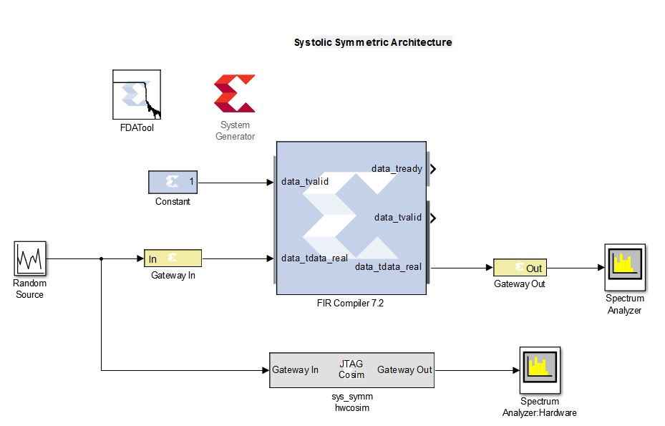
Model

Slide 9
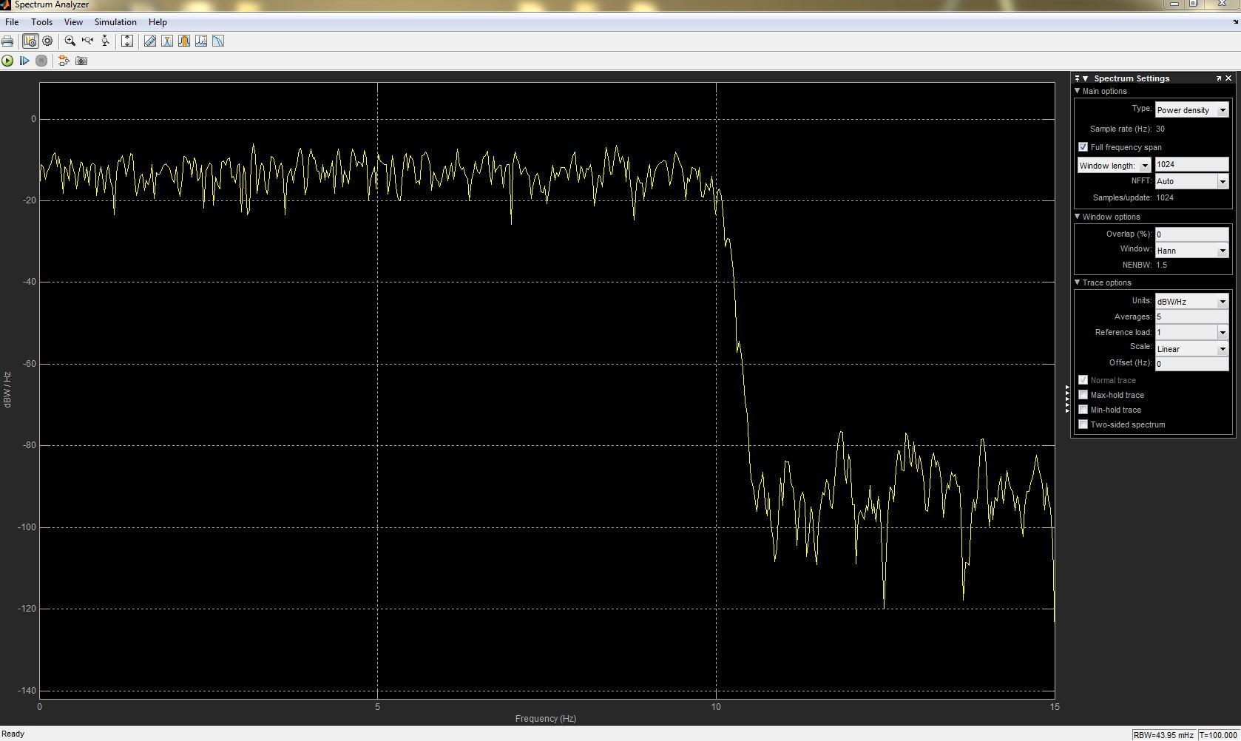
Frequency Response: Software

Slide 10
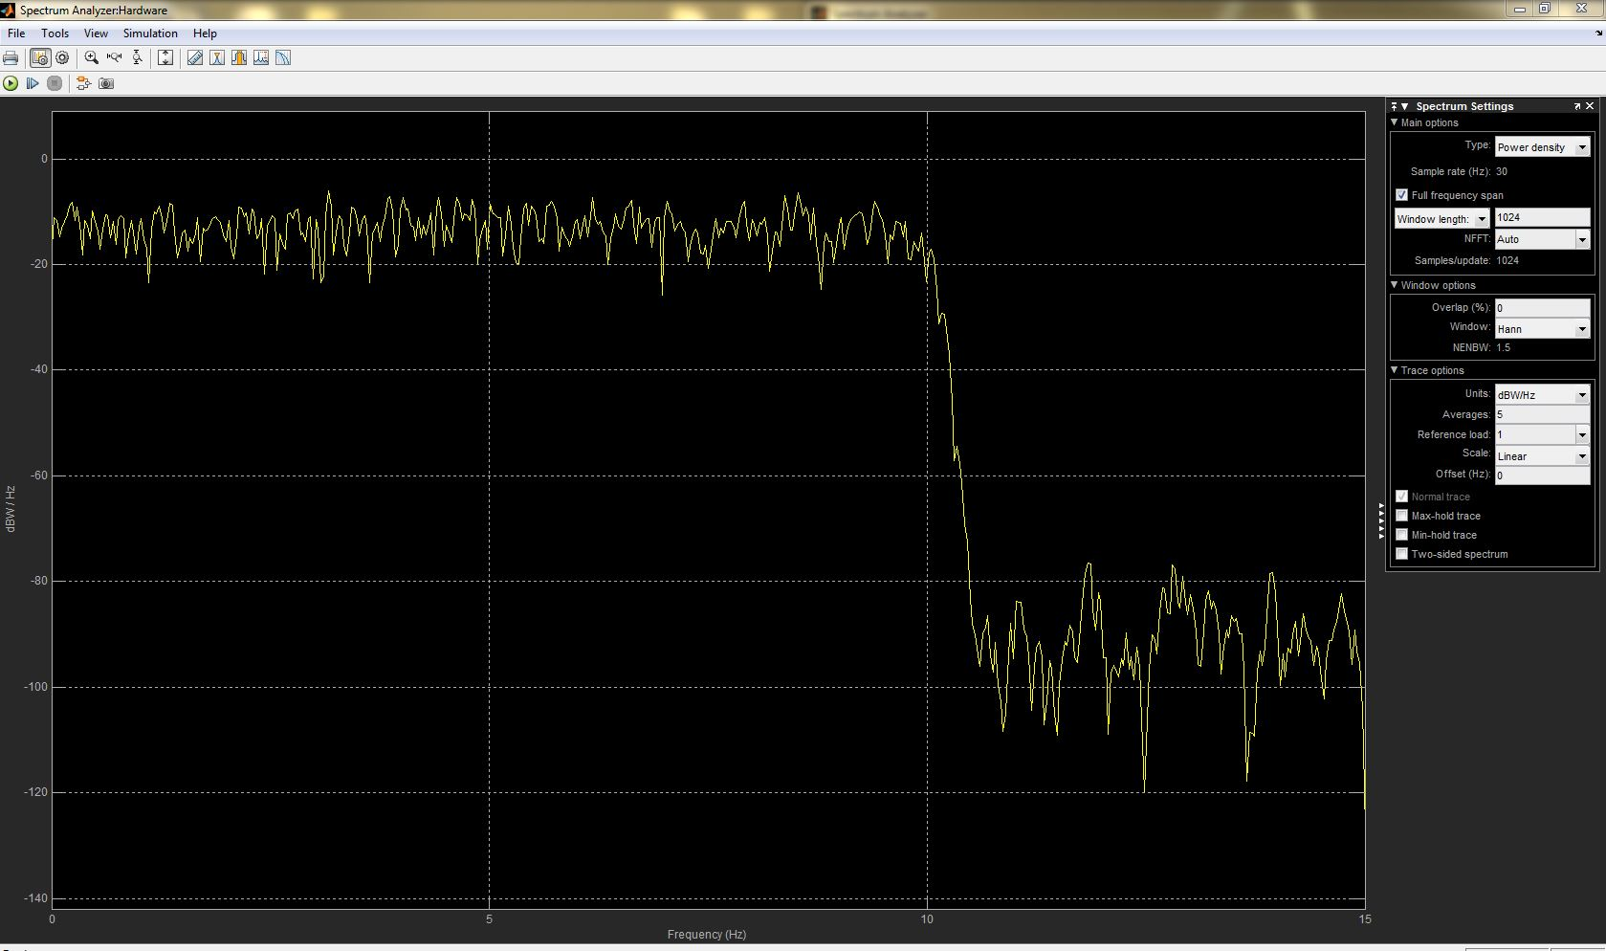
Frequency Response: Hardware

Slide 11
Hardware Utilization
Resource | Estimation | Available | Utilization %
LUT | 2813 | 53200 | 5.29
LUTRAM | 1956 | 17400 | 11.24
FF | 3395 | 106400 | 3.19
DSP | 83 | 220 | 37.23

Slide 12
Systolic Asymmetric Architecture

Slide 13
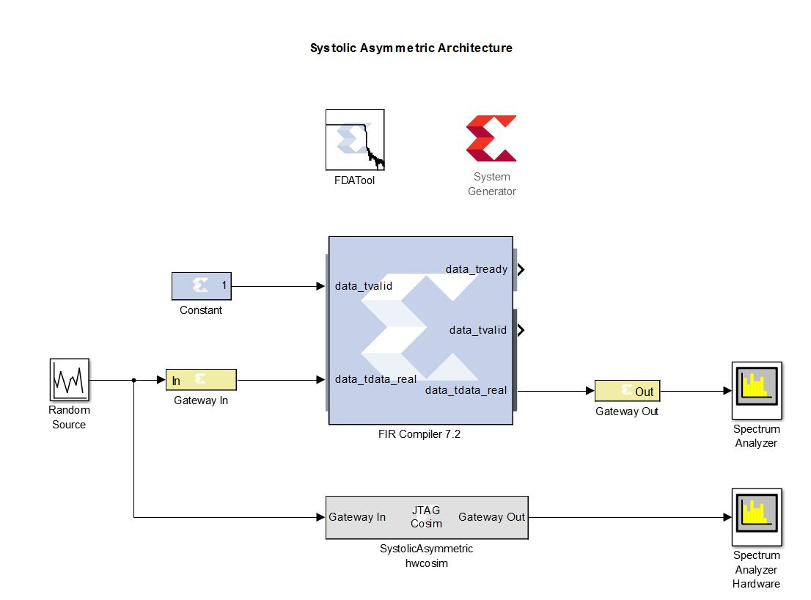
Model

Slide 14

Frequency Response: Software

Slide 15
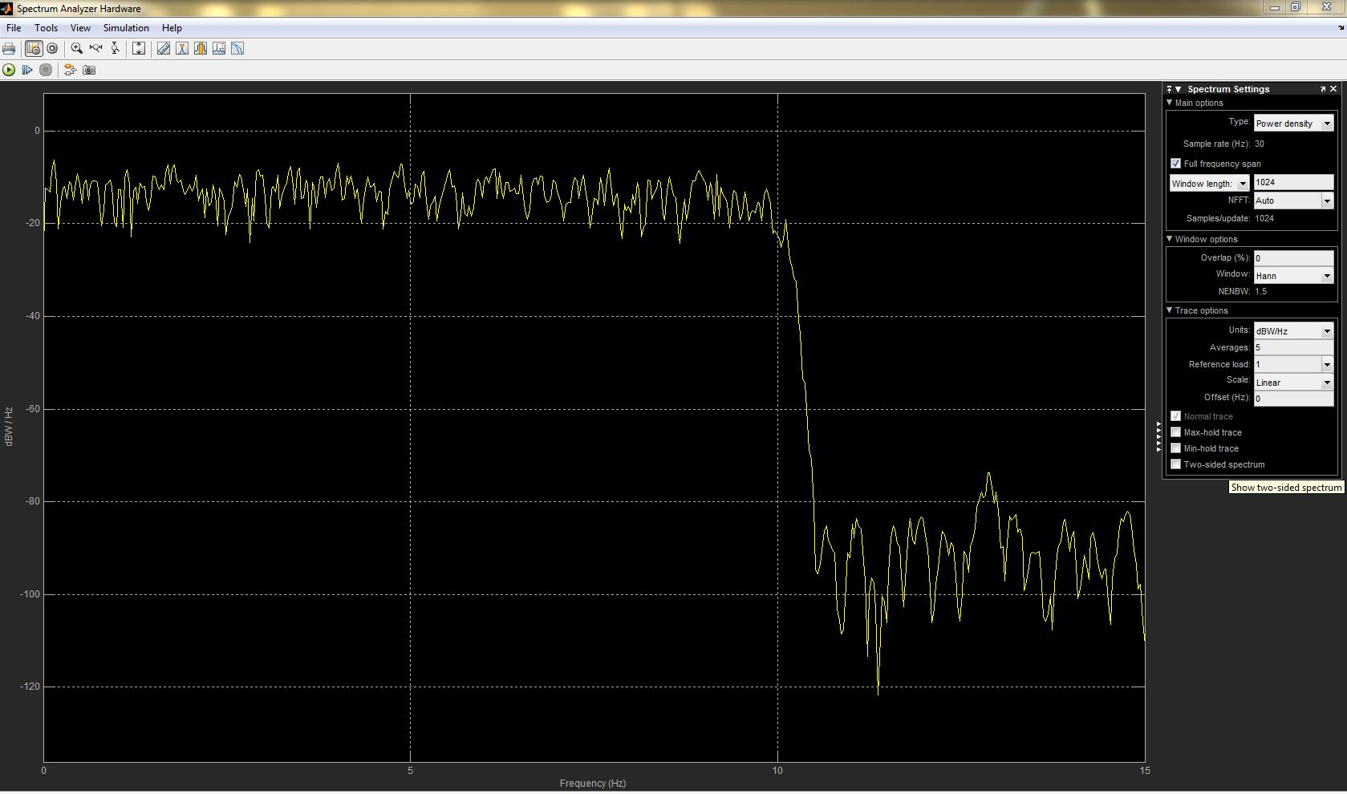
Frequency Response: Hardware

Slide 16
Hardware Utilization
Resource | Estimation | Available | Utilization %
LUT | 2275 | 53200 | 4.28
LUTRAM | 1335 | 17400 | 7.67
FF | 3230 | 106400 | 3.04
DSP | 166 | 220 | 75.45

Slide 17
Transpose Architecture

Slide 18
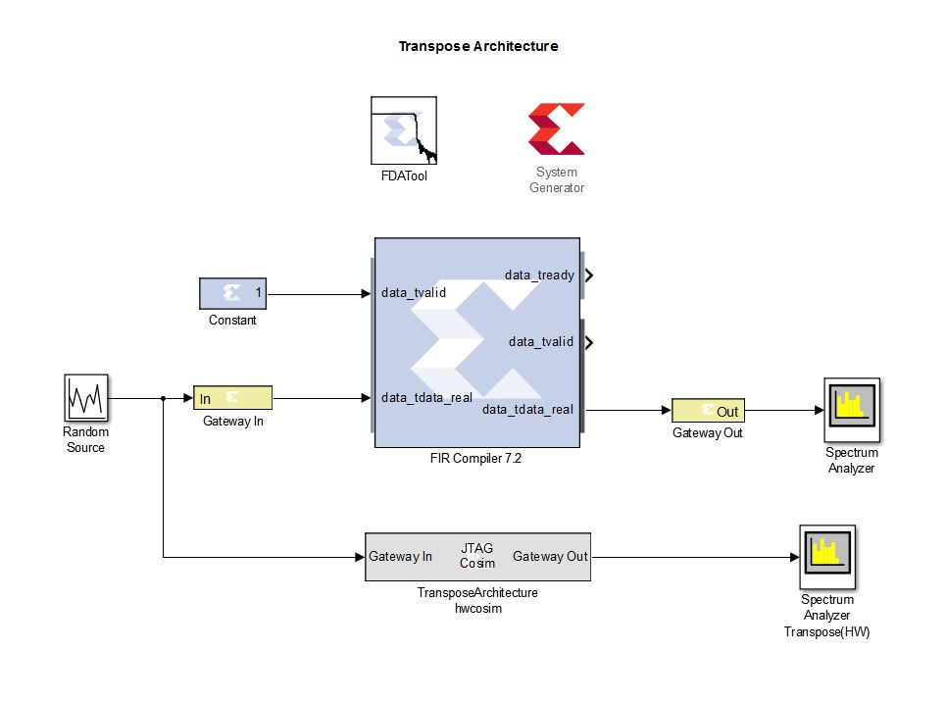
Model

Slide 19
Frequency Response: Software

Slide 20
Frequency Response: Hardware

Slide 21
Hardware Utilization
Resource | Estimation | Available | Utilization %
LUT | 835 | 53200 | 1.57
LUTRAM | 47 | 17400 | 0.27
FF | 1493 | 106400 | 1.40
DSP | 166 | 220 | 75.45

Slide 22
Comparison of Hardware Utilization
Architectures | LUT | LUTRAM | FF | DSP
Symmetric Systolic | 2813 | 1956 | 3395 | 83
Asymmetric Systolic | 2275 | 1335 | 3230 | 166
Transpose | 835 | 47 | 1493 | 166

